Slide 1
Implementation of a Design Review Application
Using Virtual Reality- and Gesture Recognition Technology

Slide 2
About the Design Review Application
An application created to enhance the process of reviewing design models. At its core, the Design Review Application is a..
Virtual reality model inspector.
The user can traverse the model with 5-6 DOF (degrees of freedom).
The user can scale the model.
Model annotator tool.
The user can create two kinds of annotations: Point- and object annotations.
These can be edited and categorized.
Proof-of-concept of how VR and gestures can be utilized for these purposes.
The user can perform all these actions by gestures alone.
Additionally, the user can also access a menu only by using gestures.
In the future: A 3D model collaboration tool.

Slide 3
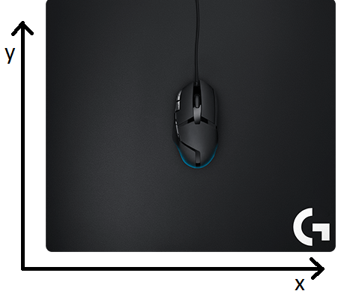
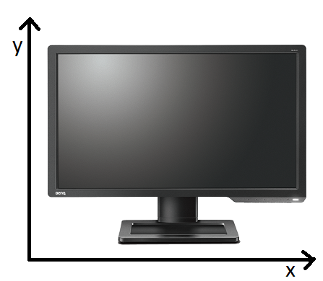
Motivation: 3D models in 2D
3D models have been important in several industries for decades, yet little has happened in how they are worked and interacted with.
The 3D models themselves are using three dimensions, but are still interfaced in only two. E.g.:
Input: The mouse is using 2D.
Output: Displays produces 2D images.
Z wanted!

Slide 4
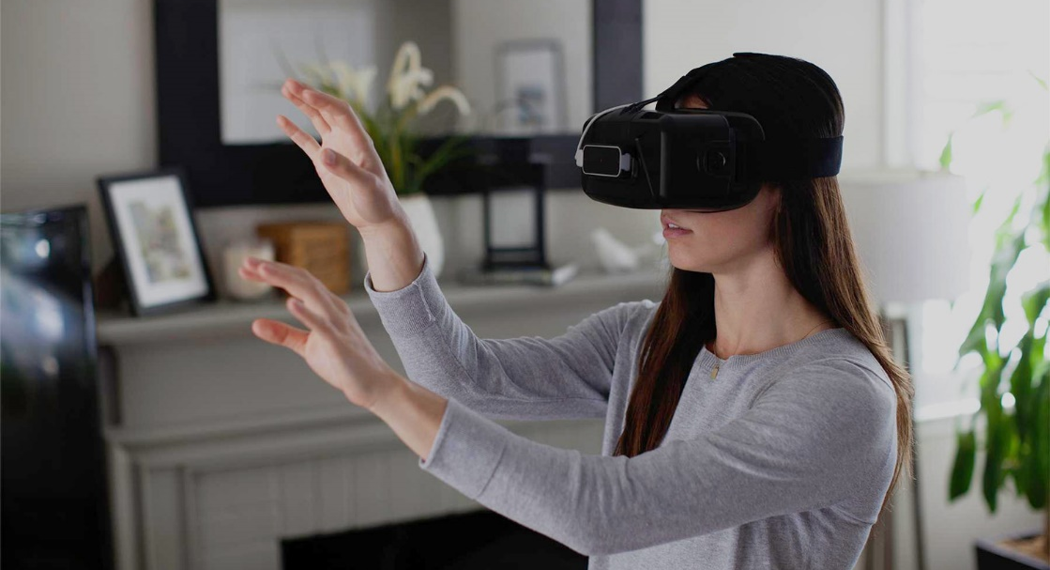
Motivation: 3D models in 2D cont.
Virtual Reality- and Gesture Recognition Technology can change this, thus possible enabling a better use of the 3D models themselves.
Input: By capturing actions performed by the users hands in three dimensions.
Output: VR headset with stereoscopic vision (individual feed per eye).

Slide 5
Motivation: Isolated model usage
Even though 3D modelling programs (e.g «CAD programs») have been around for long, their use in DNV-GL’s workflows are limited.
Current design review workflow in DNV-GL:
The designer makes a 3D design model in a CAD program.
The designer creates design documents (2D drawings) based on the model and sends them for verification.
A DNV-GL Approval Engineer (AE) reviews the documents and identifies non-conformities.
The AE builds a calculation 3D model based on the design documents.
The identified non-conformities and other observations are summzarized in a comment letter.
The designer receives these remarks and makes the neccessary changes to the design model.
The process is repeated until the design is approved.

Slide 6
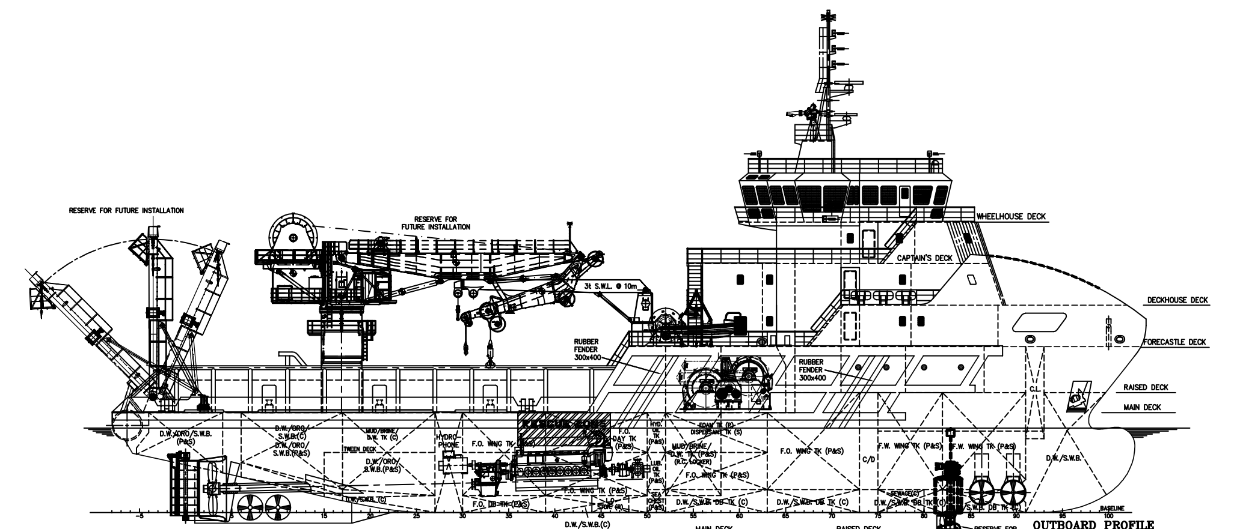
Motivation: Isolated model usage cont.
DNV-GL has demonstrated that re-using the designer’s 3D model have several benefits:
DNV-GL can avoid building a model themselves.
The designer doesn’t need to draft 2D drawings.
3D models can improve the understanding of the design.
3D models can improve the interaction between the AE and designer.
The total time required for a complete design review is reduced.

Slide 7

End goal: The digital design review workflow
Improve 3D model interaction with virtual reality and gesture recognition.
Streamline the process by removing certain steps (e.g. 2D drawings and multiple models).
Make information more organised by having it present directly in a 3D model.
Improve collaboration and communication between designer and AE by having virtual design review meetings.
Keep a history of all the changes and annotation made to the design and the 3D model.
Make the work done during the design phase more accessible during future surveys of the vessel.

Slide 8
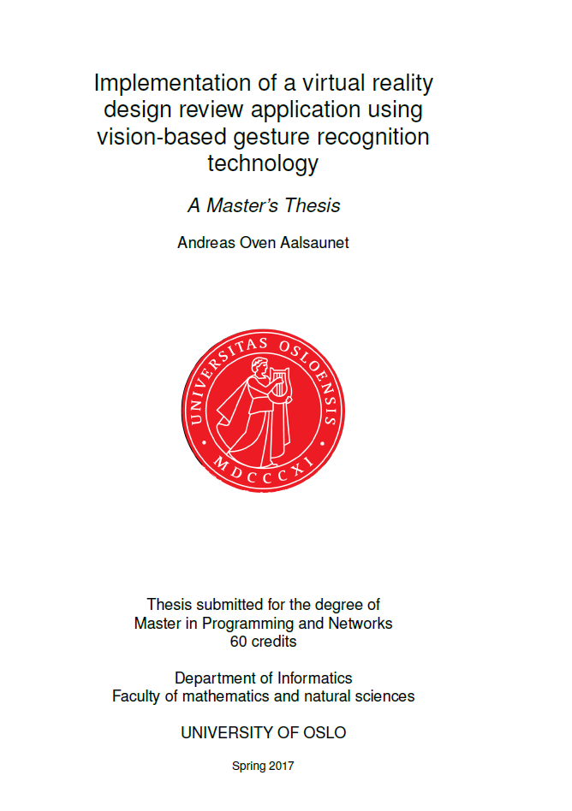
A thesis overview
The thesis..
Reviews DNV-GL primary business areas as a classification society.
Reviews important concepts of VR and GRT
Reviews the state of the art.
Reviews design concerns (e.g. VR sickness).
Discusses the required functionality.
Discusses which of these should be prioritized.
Discusses what tools are available today.
Discusses which of these would be used and why.
Documents the implementation.
Reviews responses from user tests.
Summarizes, concludes and proposes future work.

Slide 9
Many fields are relevant for the thesis
Some of these fields are:
Virtual Reality Technology.
Big impact on application design and performance aspects.
3D Rendering Techniques.
How to optimize for VR?
Many formats (at least >50), complex models.
General Purpose Game Engines.
Viable platforms for 3D- and VR-based applications.
Gesture Recognition Technology.
Offers promising interaction possibilities, but often have reliability issues.
Network Technology (e.g. with respect to collaboration aspects)
Ensuring model consistency.
VR can make lag, jitter and packet loss more critical.
Security (many strictly proprietary 3D models).
Sometimes desirable to never have the models themselves on the web.

Slide 10
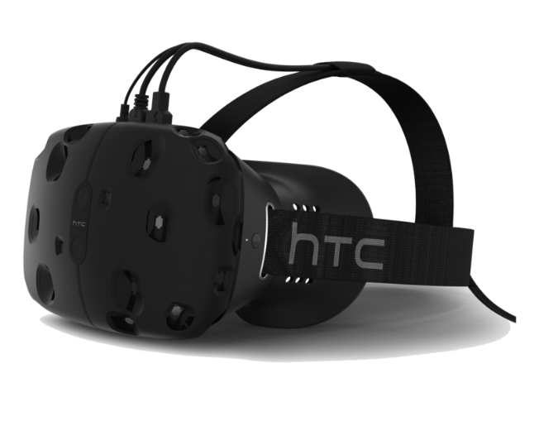
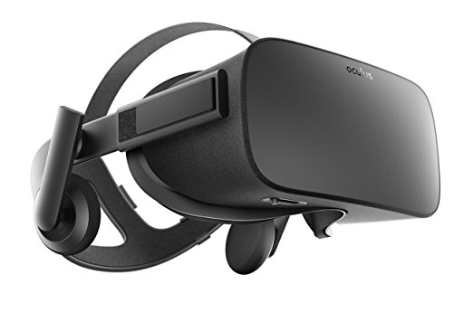
State of the art: Virtual reality technology
Virtual Reality Technology:
Oculus Rift CV1 and HTC Vive recently released.
2160×1200 resolution (1080x1200 per eye) at a refresh rate of 90 Hz.
OLED displays/lenses with a field of view (fov) of about 110 degrees.
Tracking system both in the headset and outside it (e.g “base stations”).
Very hardware demanding for several reasons.
High resolution and refresh rate, wide fov, higher user depth-awareness.
Solid SDKs that provides high level abstractions to the hardware.
Some AAA single player game titles released.

Slide 11

State of the art: Game engines
Game Engines:
Have generally become more mature, standardized and user-friendly with a broader scope (more commonly used simulators, visualizations etc).
Often have built-in support or libraries for 3rd party software or peripherals.
Often offer good deals for indie developers.
E.g Unity Personal is free for companies making less than $100k/year.
Most popular publicly available ones: Unity, Unreal Engine, CryEngine/Lumberyard.

Slide 12
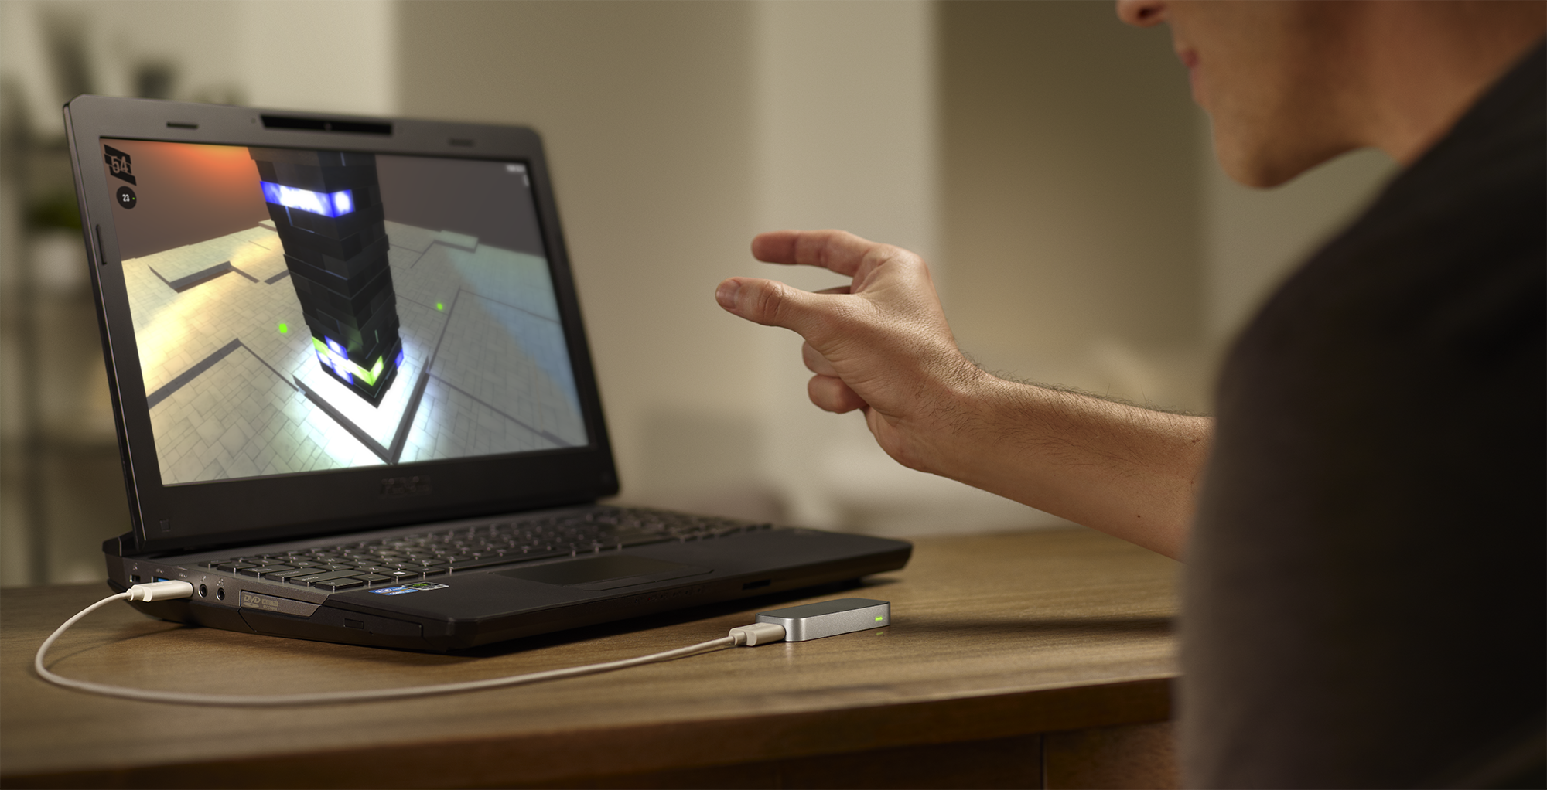
State of the art: Gesture recognition technology
There are relatively few consumer-oriented vision-based hand gesture recognition systems available today, with the Leap Motion Controller being one of the few.
Not counting systems like Xbox Kinect as these focus on the whole body.
Several companies working at consumer-oriented GRT devices after VR releases.
The field has also benefitted from the recent hype around computer vision/machine learning
Deemed as still immature.
Little used in commercial software (no AAA titles using it).

Slide 13
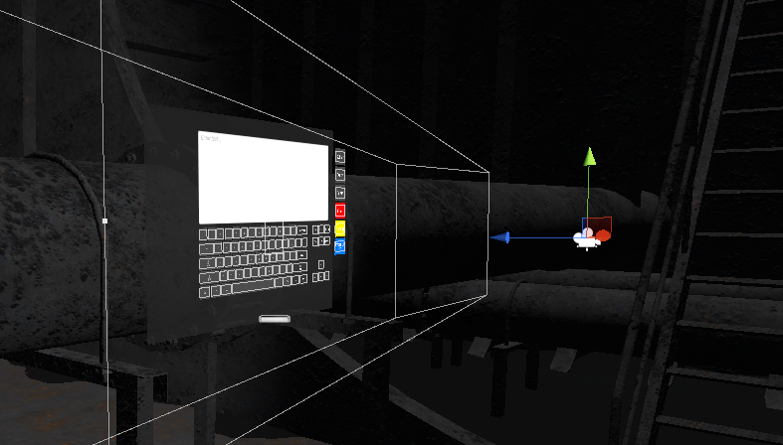
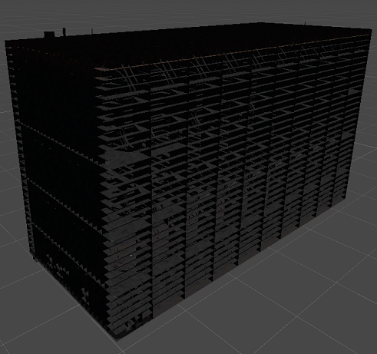
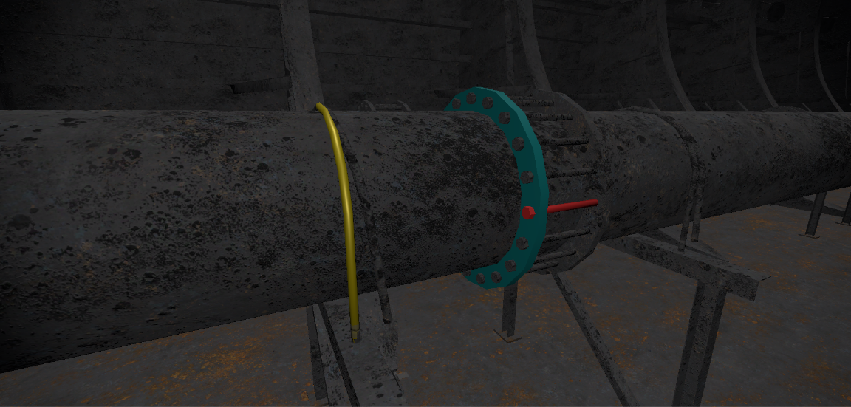
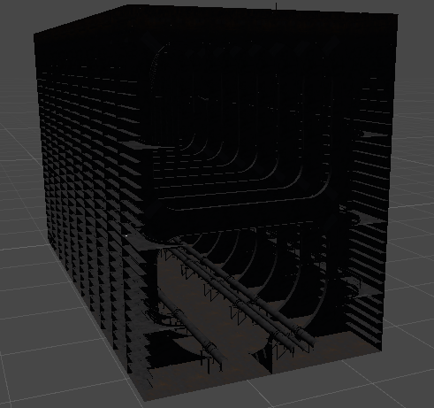
The implementation

Slide 14
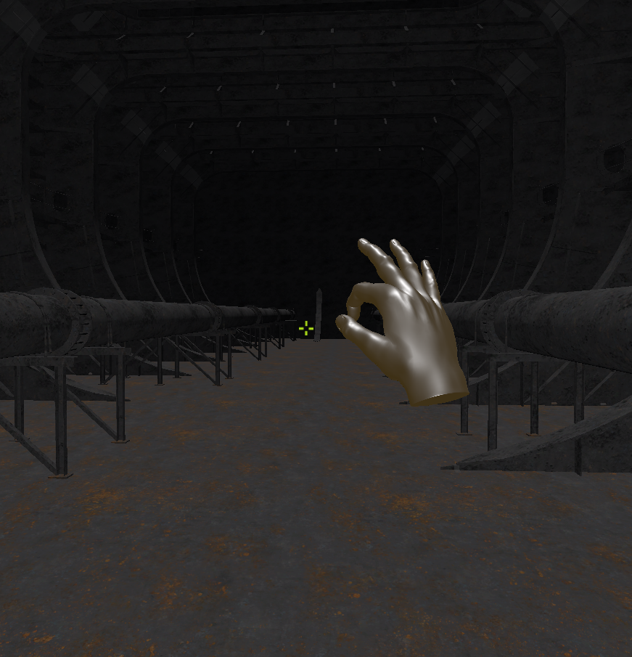
Navigation
Moving instead of teleporting
The user is able to navigate a 3D model using either mouse and keyboard or gestures.
Rotation is done by performing a pinch gesture and moving the hand in the desired rotation direction.
Movement is handled by one gesture per axis: Left/right (x-axis), up/down (y-axis) or forward/backward (z-axis).
The user can also “combine” these three gestures into one.

Slide 15
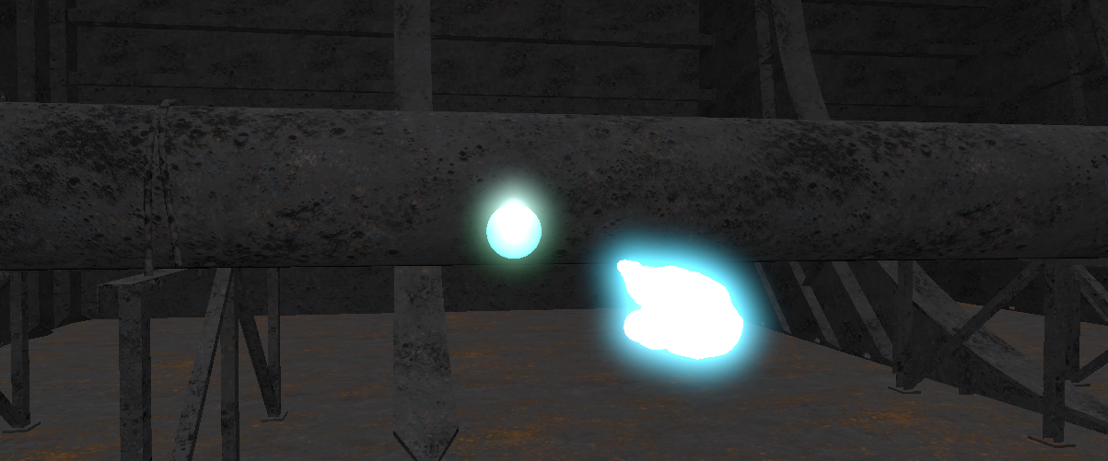
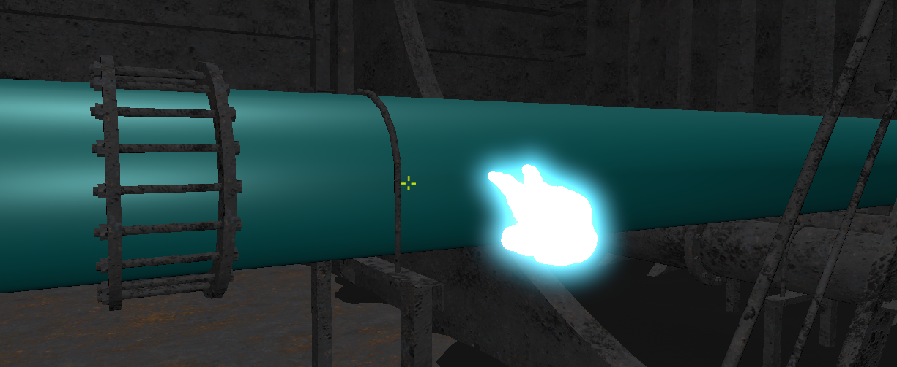
Creating annotations
The user can create point annotations or object annotations. These hold information related to the location or object they are attached to.
The annotation is created at the cursor’s location.
Point annotations are sphere 3D objects that are by default visible through other objects, to make them easy to spot. This functionality can be disabled.
Object annotations are components that are “injected” into the annotated object. Object annotations thus have no 3D representation of their own. Instead, object annotations are visible by altering the material of the annotated object.

Slide 16
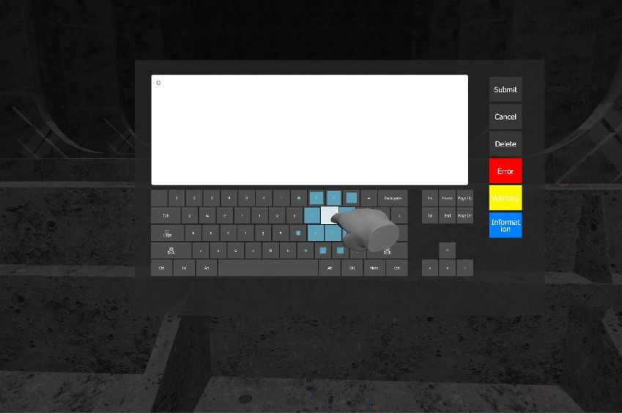
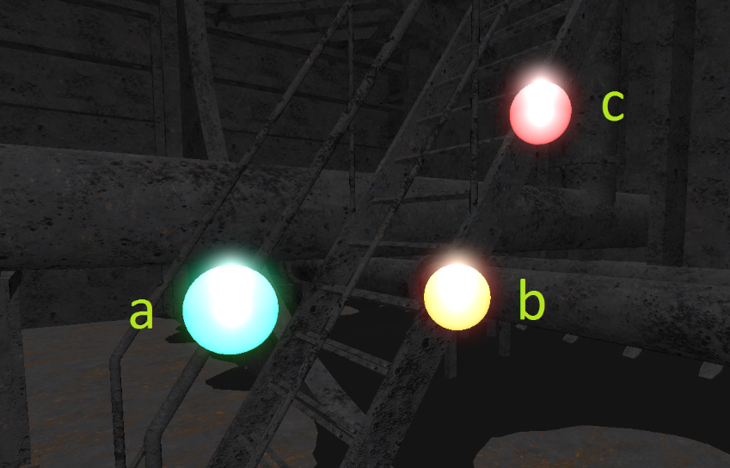
Editing annotations
Once the user interacts (i.e points or clicks) on an annotation the annotation form opens up.
The user can use gestures to input a short message and give the annotation a priority, and can then either submit the changes, cancel them or delete the annotation.
Priorities are colour coded: a) normal, b) important, c) very important.

Slide 17
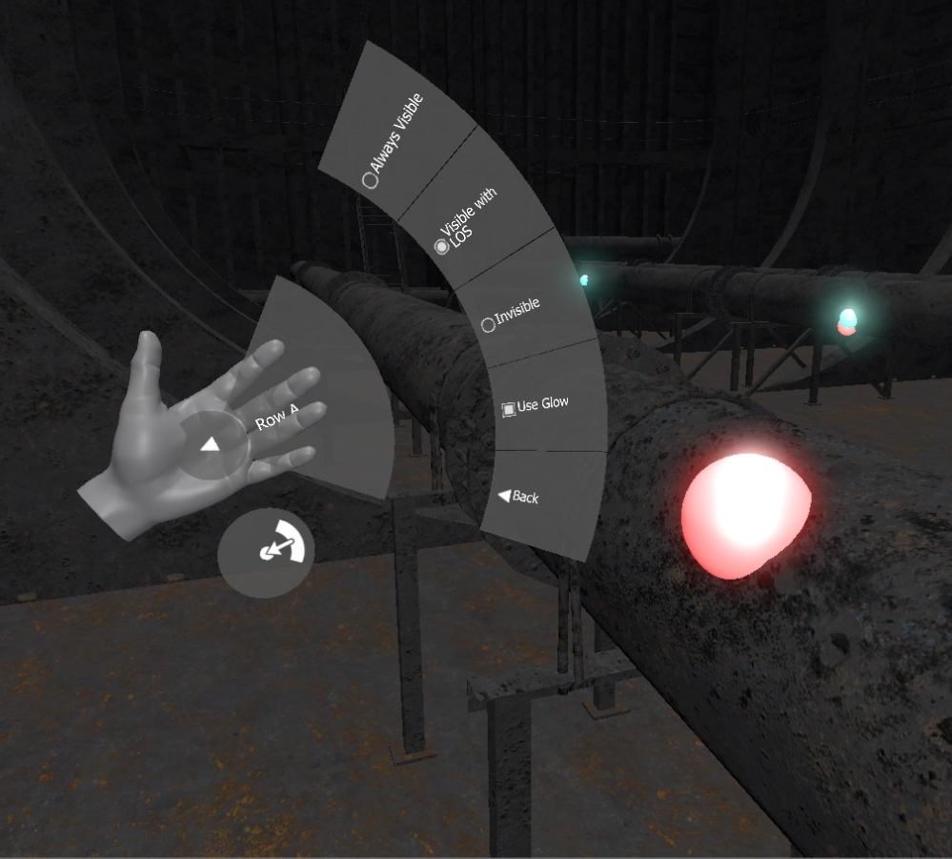
Using gestures for menu interaction
The menu enables the user to select between some limited options. This includes:
Annotation visibility levels
Movement gesture schemes
Enabling/disabling gestures
Returning to origin
Activates when the user turns a palm against the camera. Buttons are selected by the opposite hand’s index finger.

Slide 18
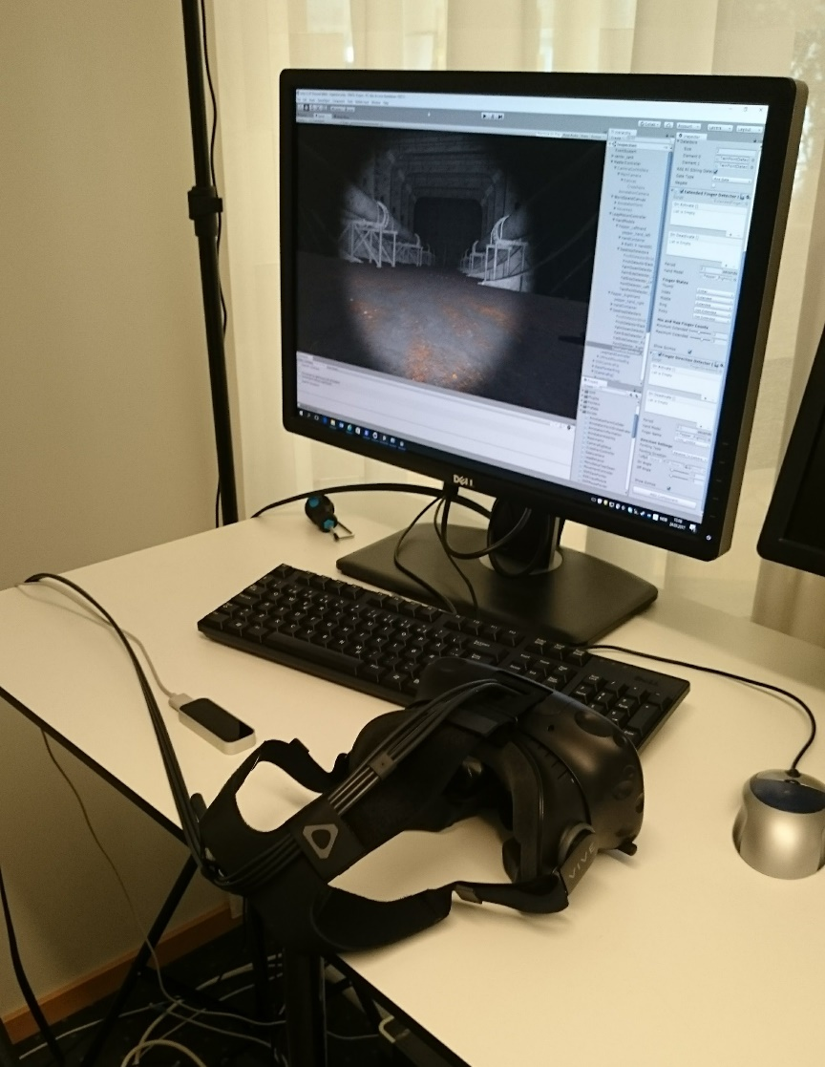
User evaluation
To evaluate the application, and various design hypothesis, the application was tested by three DNV-GL employees.
All unfamiliar with VR
All participants were given the same introduction, instructions and questions.
Some responses seem to be personal opinion and some seem unanimous.

Slide 19
Observations
Users seem to prefer having some false negatives over the same amount of false positives, thus prefering stricter gesture requirements.
The users all responded that the added depth information from VR was very useful.
This was especially the case for gestures.
The users had different preference for gestures, with some exceptions.
Varied how intuitive a gesture felt for the user.
Still, the users agreed on which gesture they liked the least.
The users all seem to prefer gestures that emulated the most natural movement patterns (e.g. forward and rotations).
Left/right and up/down wasn’t that much used.

Slide 20
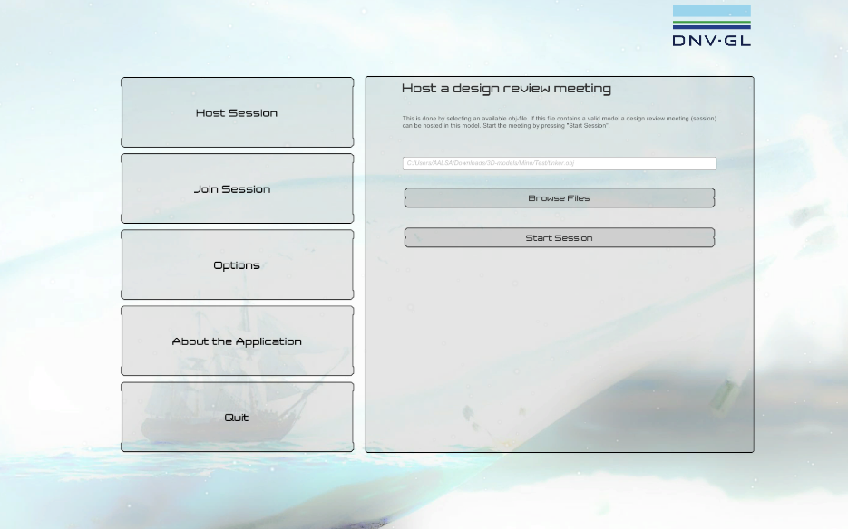
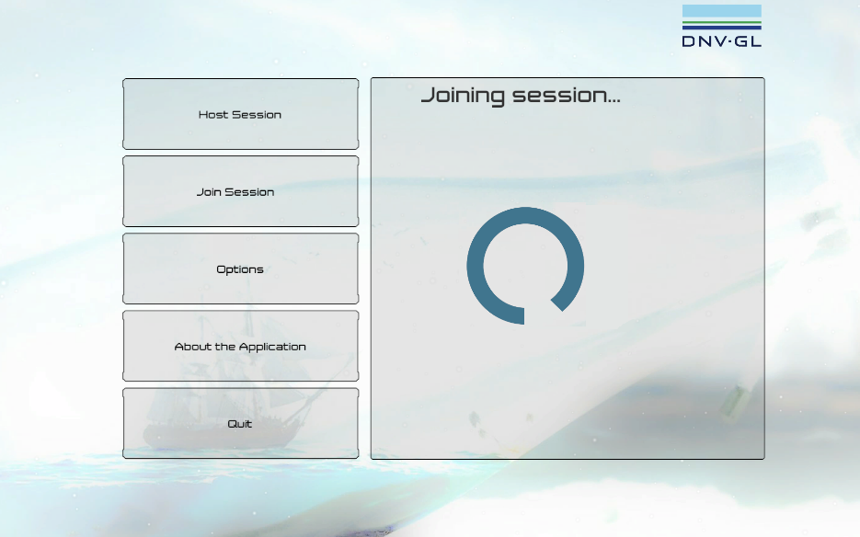
Future work
For science:
Finding recommended gesture schemes
VR sickness components
Gesture recognition systems performance vs e.g. the HTC Vive controllers.
For DNV-GL:
Happening now!
Support runtime loading of a variety of 3D models.
Session management supporting multiple users.
Storing and restoring annotations.
More complex annotations.
Exposing annotations to other platforms.
Give the user more customizable gestures.

Slide 21
Time for a demonstration!
Andreas Oven Aalsaunet
andreaoa@ifi.uio.no
+47 913 73 741

